Slide 1
Applications of analytics in operation
Submitted by :
Kiran Kumari
PDGM (Business Analytics)
181153

Slide 2
Overview
Introduction of Operations Analytics
Supply chain Analytics
Logistics Analytics
Mckinnsey&Company
WNS
Case studies

Slide 3
Operations Analytics
The industry use this terms as analytics that is done "on the fly" or in real time observation of business processes.
It will mainly focus at how specific business operations work on a daily basis and coming up with quick solutions for change.
It’s various models helps in finding what happens within a business, in real-time or over a specific time frame.
For example, businesses may be looking each day at how many customers look at or buy a particular product in an e-commerce store.
Operation Analytics tool will show you the customer behavior through live dashboards.

Slide 4
Supply Chain Analytics
Supply chain consist huge amount of historical data.
Along with maintaining the data, it is vital to understand and derive important insights from it, which would help the business grow effectively.
(i) Descriptive analytics which includes KPI tracking and internal reporting metrics based on historical data such as what sold where and how many provides the baseline analytics foundation.
(ii) Diagnostic analytics takes the data a step further by pointing to the root-cause of issues based on patterns in the historical data, enabling directional guidance for faster reactions to fix problems.
(iii) Predictive analytics uses statistical techniques to estimate the likelihood of future events such as stock outs or movements in your product's demand curve. It provides the foresight for focused decision making that avoids likely problems in the future.
(iv) Prescriptive analytics closes the loop by tying all the analytics components into actions and automated decisions (with exceptions based planning) to improve the bottom line supply chain results.

Slide 5
Logistics Analytics
Logistics analytics helps into anticipate slow and busy periods, potential future supply shortage, deliveries optimization and inefficiencies reduction.
Operational improvement due to logistics analytics:-
Forecast: It helps to plan and anticipate shifts, inventory shortages, and reduces costs.
Inventory Management: It related to storing and forecasting, the inventory management is enhanced.
Route optimization: With help of real-time GPS data, weather data, road maintenance data and fleet and personnel schedules integrated into a system looking at historical trends, the most optimized routes and time are selected for delivery.
Labor management: It helps in staff management , which is a huge asset for the supply chain where a lot of workforces is needed on a continual basis.
Automation:- Due to automation, it increased speed, accuracy and efficiency of the production process. Which will helps save a lot of time and focus on less repetitive work.

Slide 6
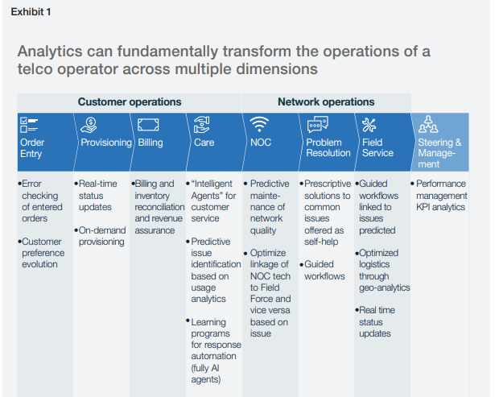
McKinnsey& Company
Case 1 :- Maximizing value from advanced
Analytics in telco service operations
In this case they are solving the problem
of churning due to not good services.
With the help of advanced analytics they are
trying to make model. Which will solve the
problem of customer operations and network
operations.

Slide 7
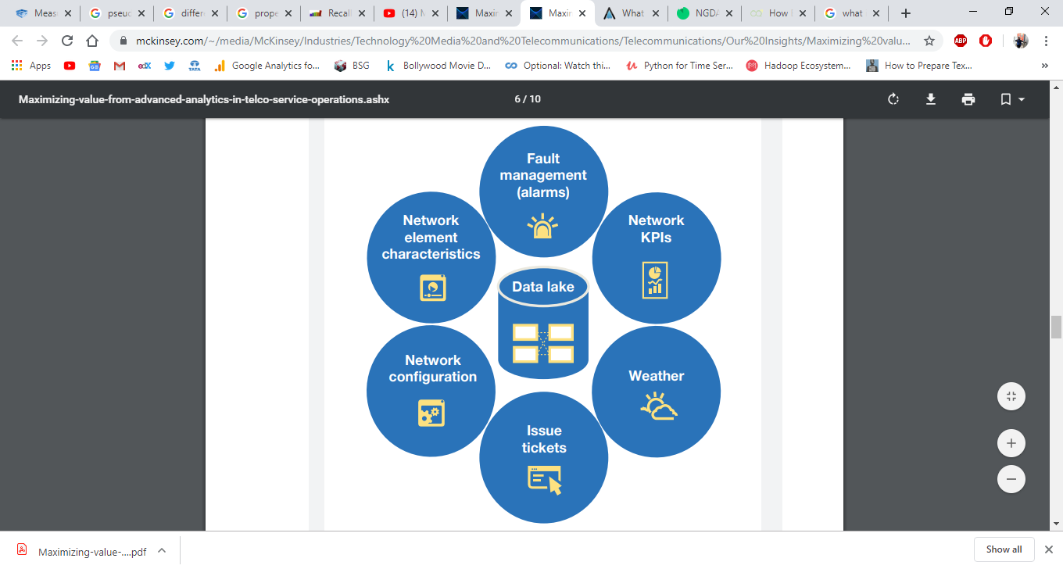
Predictive Maintenance(Network Ops.)

Slide 8
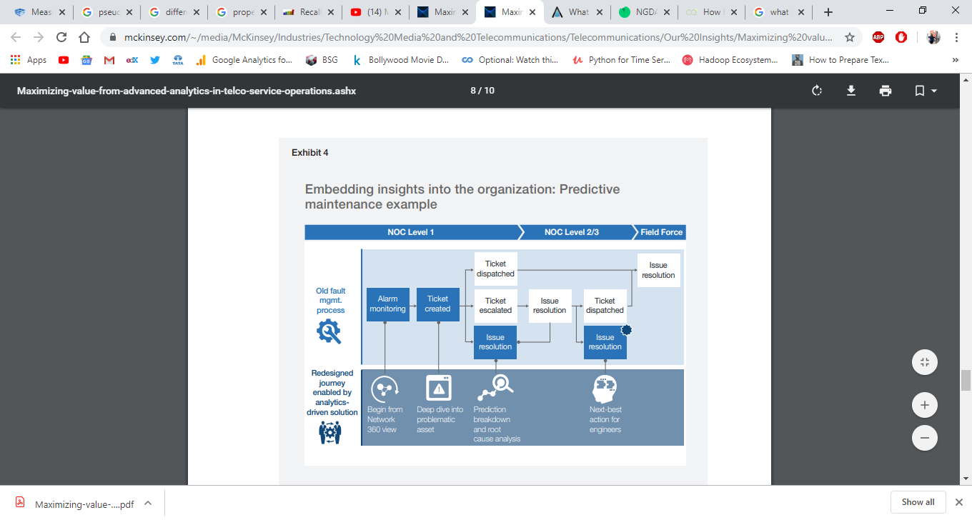
Network Operations (Model)

Slide 9
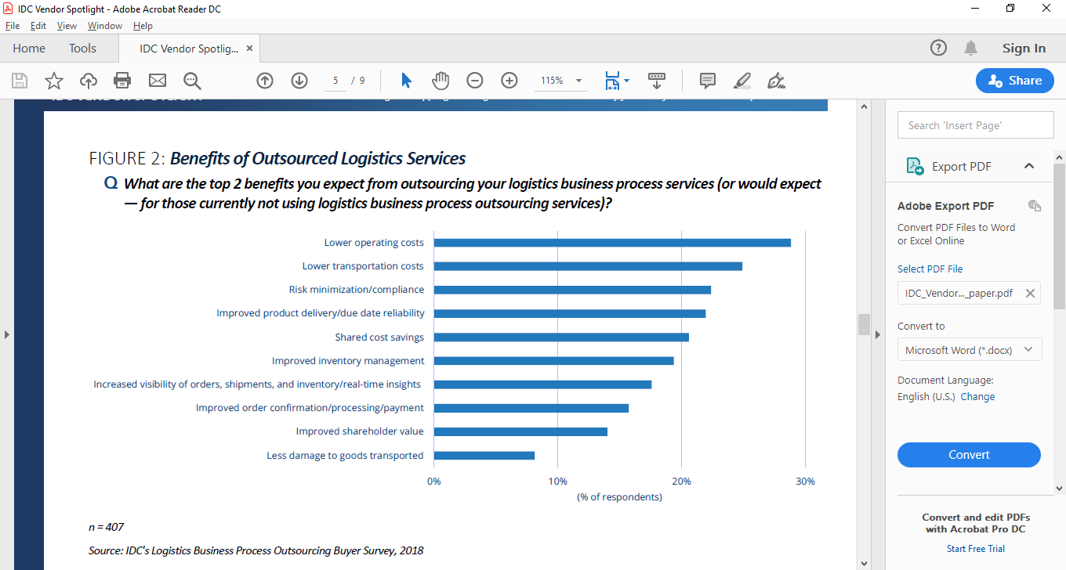
WNS
Case 2 :-
Intelligent Shipping and Logistics Services
Pave the Way for Transformed Business Operations
Benefits of Logistics analytics
In this case WNS using Logistics analytics :-
1. WNS' Shipping and Logistics Services
2. WNS' Supply Chain Management Analytics Capabilities

Slide 10
WNS' Shipping and Logistics Services
WNS partners with shipping and logistics companies across all segments — ocean, 3PL, trucking, freight forwarders, ports and terminals, and air express — to drive efficient business processes and co-create sustainable value through digital transformation.
WNS' Proprietary Shipping and Logistics Solutions
Bill of Lading Platform — WNS Malkom
Cognitive Data Capture & Processing Platform
Risk and Audit Analytics Offering
Big Data Analytics Platform – Agilius

Slide 11
WNS' Supply Chain Management Analytics Capabilities
WNS develops an analytics-led transformation road map that enables clients to understand and envision how analytics and automation can improve their operations over time.
For supply chain management analytics, WNS helps clients address industry specific challenge. Which is occurring continuously in operational activity. Like,
1. Demand Forecasting for Shipments and Inventory
2. Intelligent Network and Route Optimization
3.Predictive Bill of Lading Volumes/Forecasting
4. Driver Performance Analytics, Compliance, and Behavior Audit
5. Freight Cost Analysis
6. Inventory Optimization
7. Workload Forecasting
8. Asset Management Analytics
9. Air Waybill Processing and Identification of Early Warning Indicators of Erroneous Air Waybills
10.Dispute Prediction Analytics/Modeling for Invoice Disputes
11.Analysis of Bill of Lading Prioritization Logic for Vessel Planning and Scheduling

Slide 12
Case Studies
Mckinnesy&company
https://documentcloud.adobe.com/link/track?uri=urn%3Aaaid%3Ascds%3AUS%3A7131872a-8e82-4242-a79c-e93439de80d2
WNS
https://documentcloud.adobe.com/link/track?uri=urn%3Aaaid%3Ascds%3AUS%3Add5d311a-508f-497f-b716-5e401a51d950

